Slide 1
REINFORCEMENT LEARNING | ASSIGNMENT
Reinforcement Learning-Based
Animal Foraging Behavior Using Q-Learning
MOTIVATION : Simulate an animal choosing between food patches and compare its learned foraging policy with optimal-foraging principles.
TEAM MEMBERS :
1. D. Charan Teja – 100523733016
2. S. Aishwarya – 100523733051

Slide 2
METHOD
Q-learning algorithm • states, actions, rewards and training protocol
Learning rule
Q(s,a) ← Q(s,a) + α [r + γ max Q(s′,a′) − Q(s,a)]
Learning rate α = 0.12; discount γ = 0.95.
Observe current patch + food levels
↓
Choose STAY / SWITCH (ε-greedy)
↓
Exploration and training
Collect reward; update Q-table
ε-greedy policy: ε decreases from 1.00 to 0.05.
2,500 episodes per seed × 20 seeds.
↓
Repeat until episode ends
2/5

Slide 3
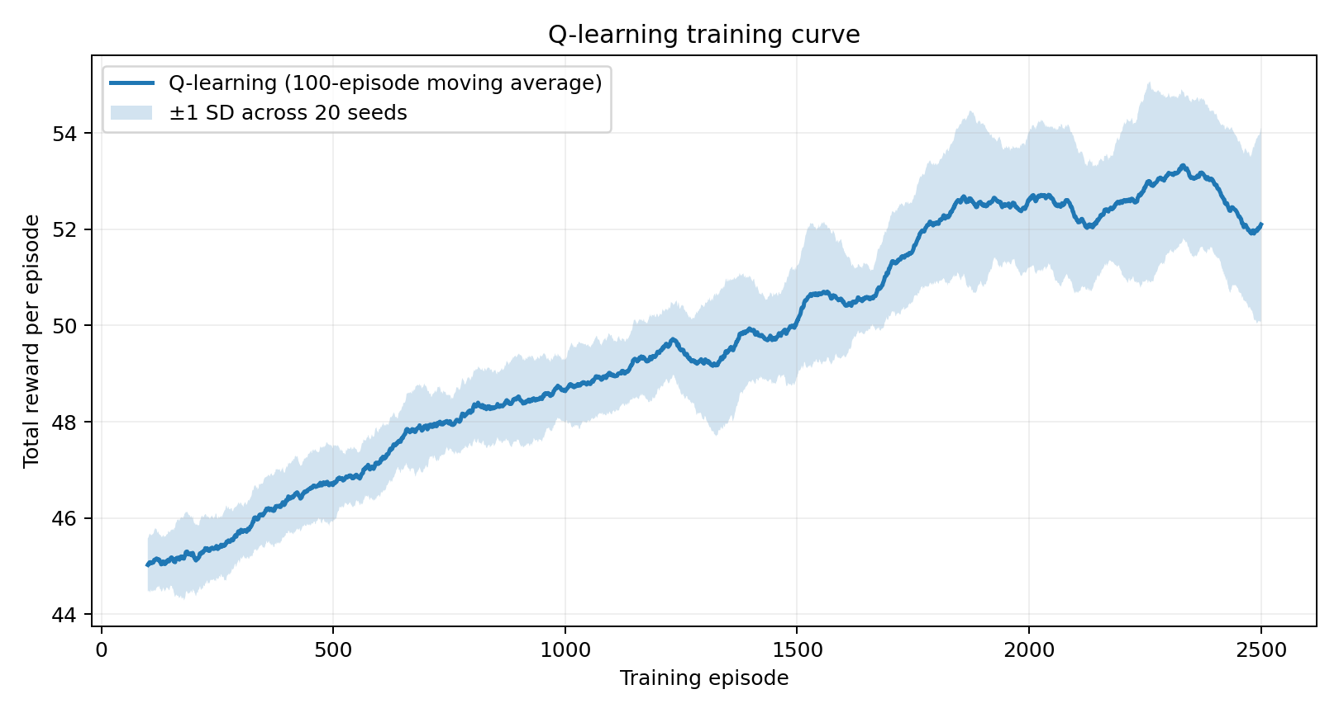
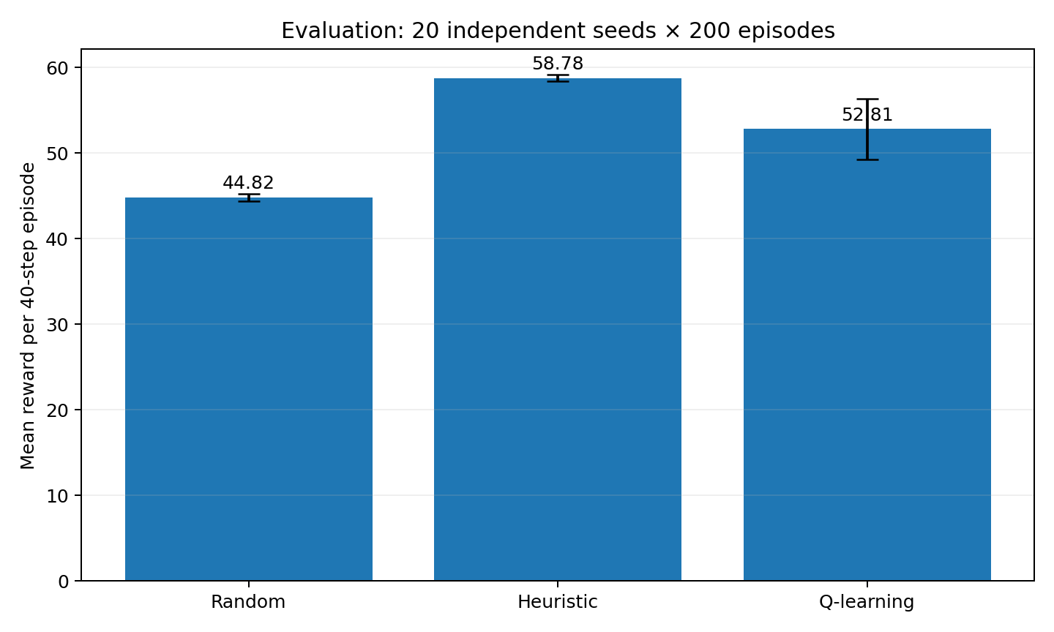
RESULTS
Actual learning curves and baseline comparison from the Python experiment
Mean reward: Q-learning 52.81 | Random 44.82 | Heuristic 58.78
3/5

Slide 4
LIMITATIONS
Model assumptions • constraints • opportunities for improvement
Simplified environment
Assumed dynamics
Only two food patches, 32 discrete states and 40 steps per episode; real habitats are more complex.
Food values, depletion, regeneration and movement penalties are synthetic rather than measured in nature.
Limited observability
Baseline performance
The agent observes exact food quantities in both patches; real animals must infer hidden food availability.
The heuristic (58.78) outperformed Q-learning (52.81). More tuning and richer state models may help.
4/5

Slide 5
ETHICS
Responsible interpretation, scientific transparency and final takeaway
No animal testing
Avoid overstating findings
The project uses a simulated environment only; no animals, human participants or personal data are involved.
Q-learning beats random (52.81 vs 44.82), but not the heuristic (58.78). Report both results transparently.
Scientific responsibility
Conclusion
Synthetic parameters and a simplified setting limit biological validity; real-world claims require independent validation.
Tabular Q-learning learns useful foraging decisions. Future work could model uncertainty, more patches and seasonal change.
5/5

